Slide 1

treatment bloomington
Assistance into safe and supportive living arrangements
residential, supportive, structured

Slide 2
HEALTH CARE
Free downtown emergency care
County Health Detox with further programming
More access to healthcare providers, including mental health - increasing choice
Alternative pain management
Mindful movement (eg. yoga, exercise, breathing)
Spiritual & emotional care (eg. education, therapeutic resources)
HealthNet: Access, integration, and clear communication
Reduce Insurance issues (eg. Barriers to getting insured, addressing gaps in insurance or people who are under-insured)
Addiction harm reduction
Abundant, accessible, affordable therapy
Legalize cannabis as options for alternative pain management
HOUSING
Sober living
Affordable, low-barrier Housing
Rental assistance fund
More supportive reintegrative housing- offer a spectrum of options to meet peoples' needs
Tenant protections (eg. limits on rent increases)
Pathways and institutional support to home ownership
More funding for Courage to Change etc.
Post felony landlord education
First-time homeowner grants
A reminder of the good ideas
from the Nov 12 meeting
at the Overlook
CRISIS RESPONSE
Non-police intervention
Harm reduction (eg. Indiana Recovery Alliance)
Mobile crisis response (eg. Peer support, EMT, Social work van)
Redirect mental health crisis calls to 988 instead of 911
Support STRIDE center
Transparency
More people in specialist roles (eg. mediation, peer supports)
Neighborhood organizing
Disarm police and mandating non-handcuff arrests

Slide 3
The Year is 1968

Slide 4
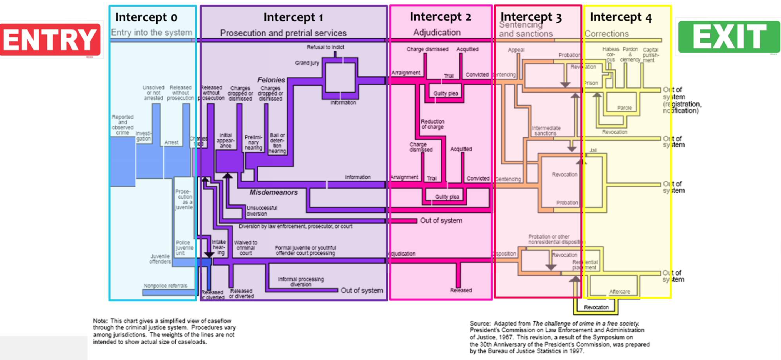
Katzenbach Commission in 1967
The President's Commission on Law Enforcement and Administration of Justice was a group of 19 people appointed by President Johnson in 1967 to study the American criminal justice system. Johnson assigned the group the task of fighting crime and repairing the American criminal justice system:
No agency of government has ever in our history undertaken to probe so fully and deeply into the problems of crime in our nation. I do not underestimate the difficulty of the assignment. But the very difficulty which these problems present and the staggering cost of inaction make it imperative that this task be undertaken.
— President Lyndon Johnson ^{[1]}
The Commission's final report was issued in 1967^{[2]} has been described as "the most comprehensive evaluation of crime and crime control in the United States at the time".^{[3]} It laid out reorganization plans for police departments^{[4]} and suggested a range of reforms.^{[5]} Several of the Commission's findings related to the poor treatment of juvenile offenders.^{[6]}
Intercept MODEL

Slide 5
Person is reported for criminal act.
A crime is behavior that is punishable as a public offense. The
elements of a crime generally come from statutes, but may also be supplied by the common law in states where the criminal common law still carries force.

Slide 6
A person is able to live in our community

Slide 7
A lot has happened
We need to think outside of the Intercept Model.

Slide 8
Even this one
Removing the crisis to Law Enforcement connection

Slide 9
HEALTH CARE
Free downtown emergency care
County Health Detox with further programming
More access to healthcare providers, including mental health - increasing choice
Alternative pain management
Mindful movement (eg. yoga, exercise, breathing)
Spiritual & emotional care (eg. education, therapeutic resources)
HealthNet: Access, integration, and clear communication
Reduce Insurance issues (eg. Barriers to getting insured, addressing gaps in insurance or people who are under-insured)
Addiction harm reduction
Abundant, accessible, affordable therapy
Legalize cannabis as options for alternative pain management
HOUSING
Sober living
Affordable, low-barrier Housing
Rental assistance fund
More supportive reintegrative housing- offer a spectrum of options to meet peoples' needs
Tenant protections (eg. limits on rent increases)
Pathways and institutional support to home ownership
More funding for Courage to Change etc.
Post felony landlord education
First-time homeowner grants
A reminder of the good ideas
from the Nov 12 meeting
at the Overlook
CRISIS RESPONSE
Non-police intervention
Harm reduction (eg. Indiana Recovery Alliance)
Mobile crisis response (eg. Peer support, EMT, Social work van)
Redirect mental health crisis calls to 988 instead of 911
Support STRIDE center
Transparency
More people in specialist roles (eg. mediation, peer supports)
Neighborhood organizing
Disarm police and mandating non-handcuff arrests

Slide 10

Local History
Centerstone was working with the Monroe County representatives to setup the Stride location with the Stride Coalition on property purchased in 2018 which also houses a secured parking facility. Probation was moved to it’s currently location. Both of these places are now located next to the courts, the jail and the community services available.
Also purchased at that time was additional land at 615 S Adams portions of which had been developed into a Youth Shelter and Binkley House which serves as emergency housing for children (voluntary and not ), which are without violent histories and without substance abuse disorders.
Pathways program - developed and provided direct support of an “Interventionist” around this time. Dated material but still available at https://bloomington.in.gov/sites/default/files/2018-09/Resource Guide -Substance Use Disorder.pdf (Image above )
The Fullerton Pike Phase II was in place.
in 2018 a Commission on Affordable Housing was formed by Ordinance.

Slide 11
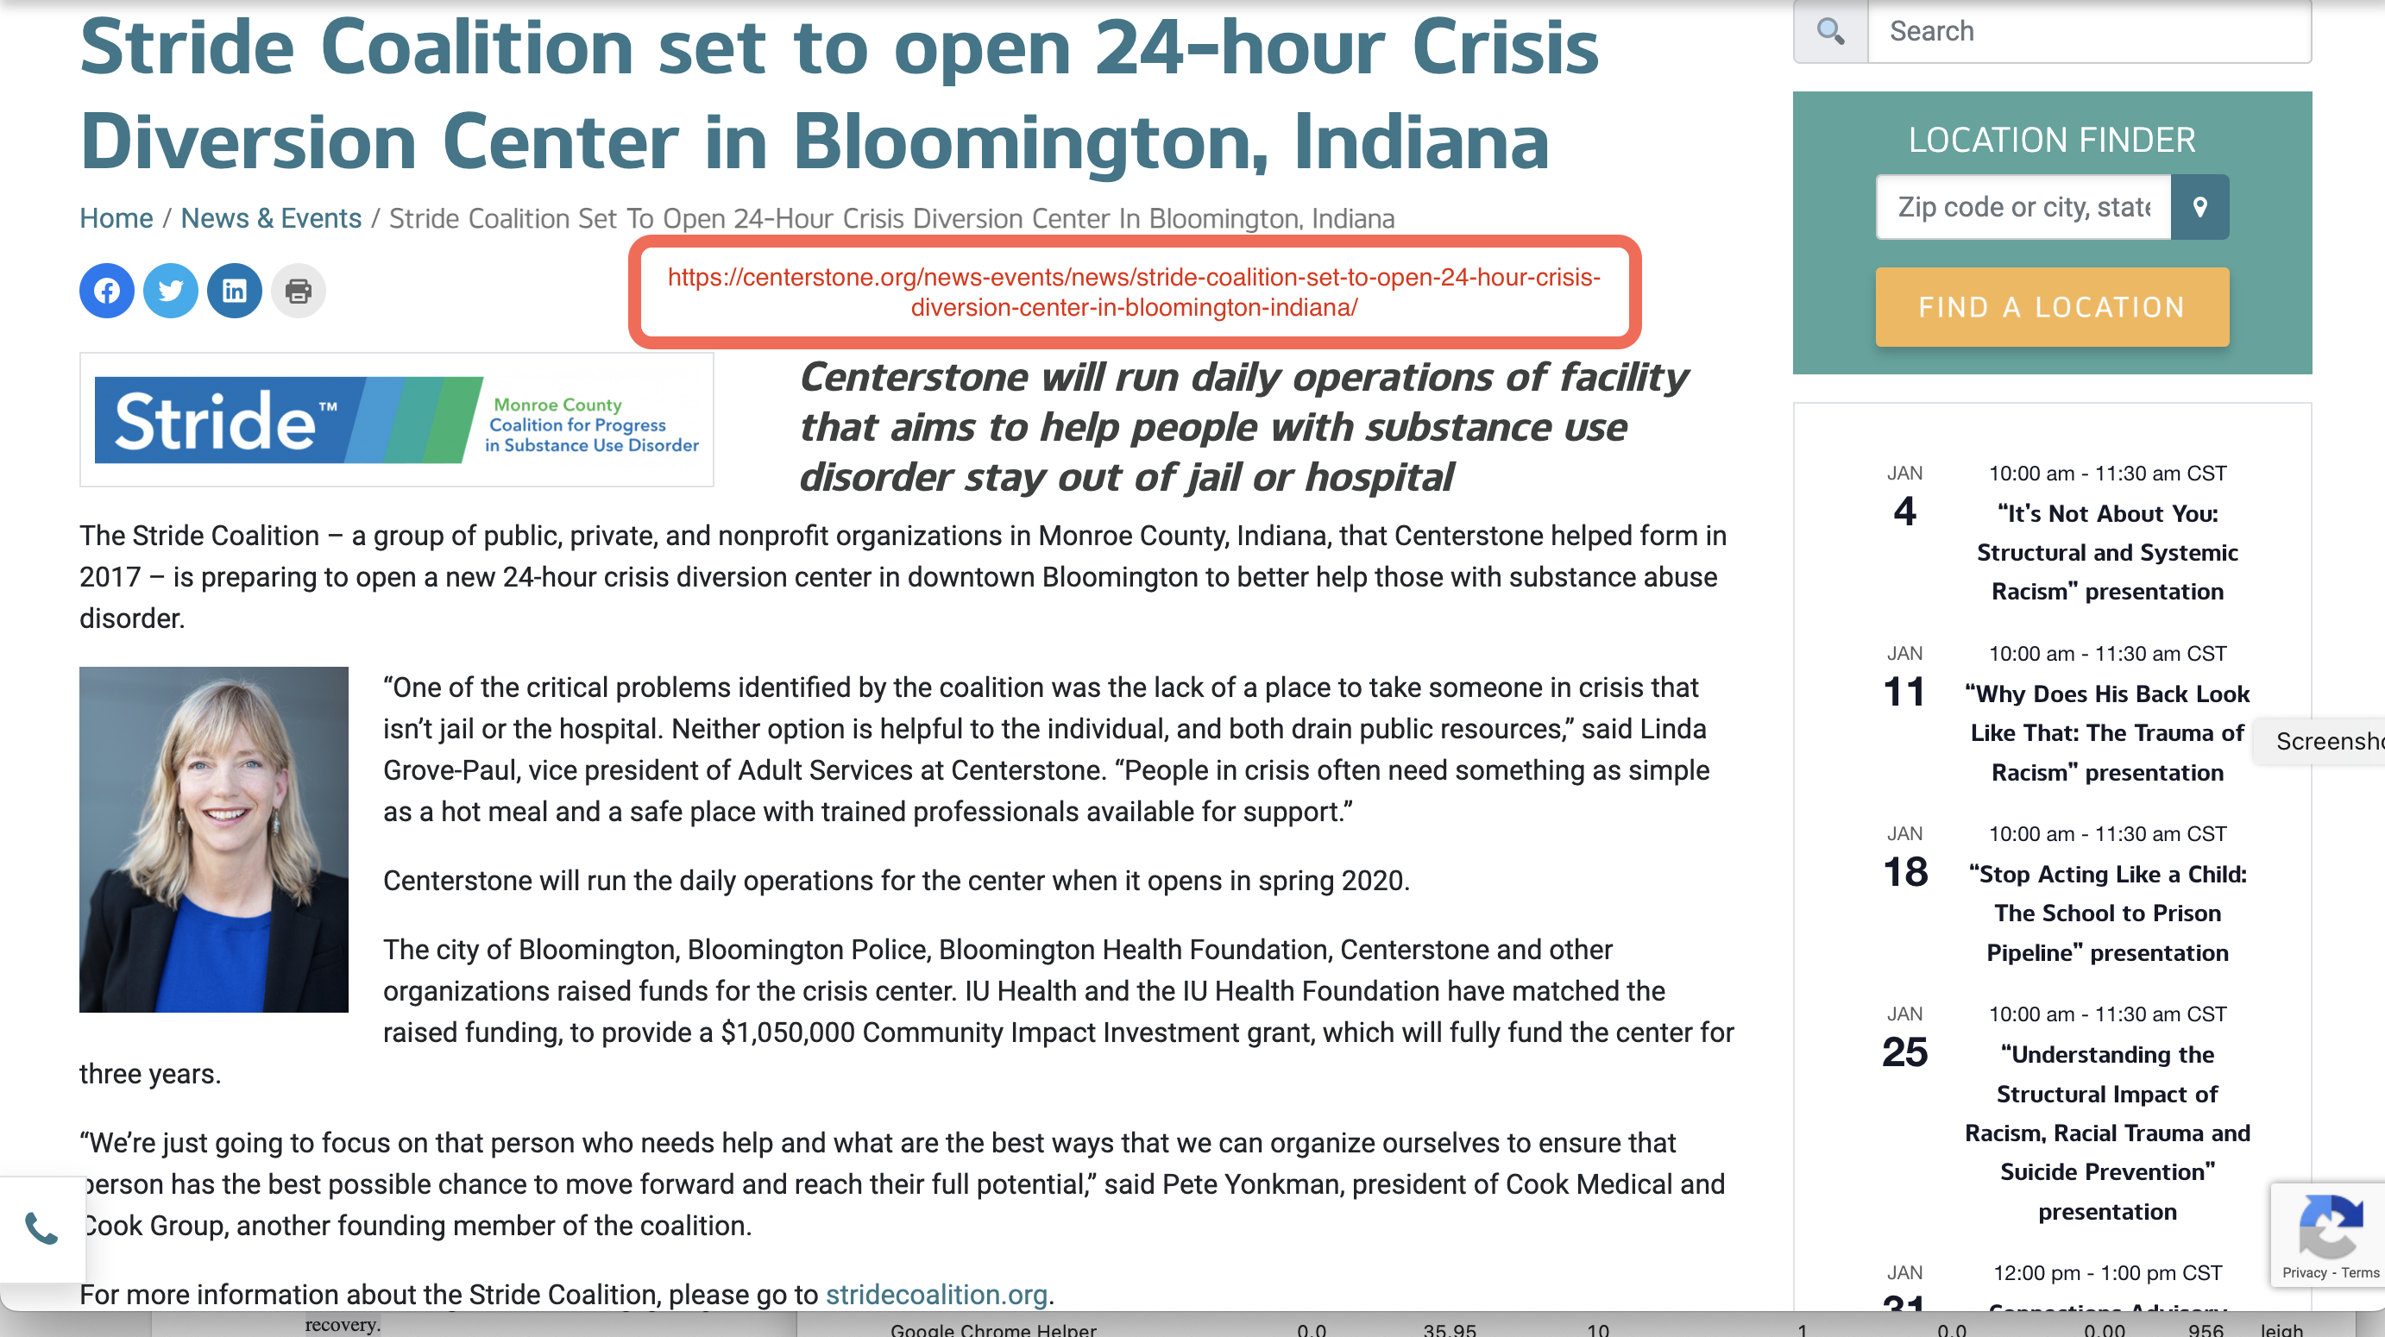

Slide 12

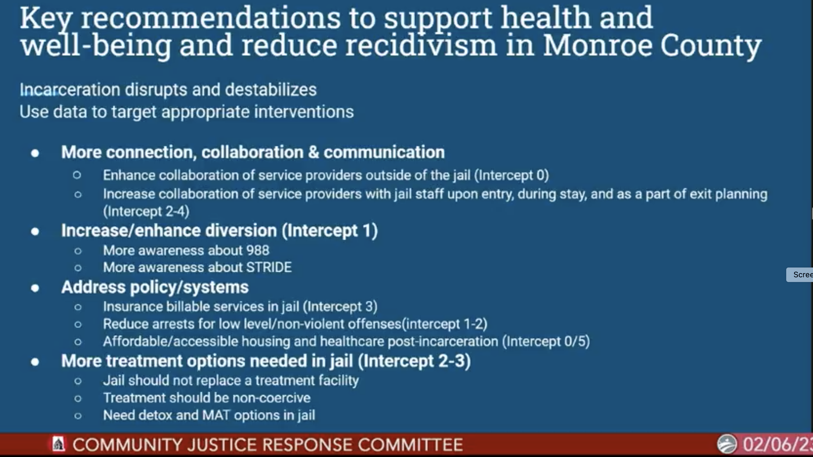
INTERCEPT -

Slide 13
enhance and increase diversion
Add progress in this area.
Funds limited due to lack of the ability to fund with an incarcerated person’s insurance.

Slide 14


Crisis services overview flowchart option 1
988 Suicide and Crisis Lifeline was created to address the increase in mental health crises. Provided by Indiana Family and Social Services Administration
Stride Center - Safe de-escalation place for people in substance use crisis. The Stride Coalition.
Monroe County Youth Shelter - Binkley House 12 paid staff members
Medical stabilization - Detox - IU Health, Boca Treatment Center?
Treatment - residential, structured, usually 30 day program
Transitional Housing - Learning, skill development, ?
Low income housing tax credit management property Rental Units.
Kinser Flats LP
Use public or private health insurance treatment options

Slide 15
Crisis services overview flowchart option 2
988 Suicide and Crisis Lifeline was created to address the increase in mental health crises. Provided by Indiana Family and Social Services Administration
Stride Center - Safe de-escalation place for people in substance use crisis. The Stride Coalition.
Monroe County Youth Shelter - Binkley House 12 paid staff members
Medical stabilization - Detox - IU Health, Boca Treatment Center?
Treatment - residential, structured, usually 30 day program
Transitional Housing - Learning, skill development, ?
Low income housing tax credit management property Rental Units.
Kinser Flats LP
Use Monroe County Correctional Contract health treatment options

Slide 16
Resources Not Money
Care not Cages
How and where to place support
Care not Cages

Slide 17
Transportation
Health Care which is not coercive
Legal Assistance
Food
Clothing
Housing

